Slide 1

COVID-19 DATA ANALYTICS AND FORECASTING
Proud Cockroaches

Slide 2
Abstract
This project gives an overview of the most recent pandemic of the novel coronavirus 2019 (COVID-19) and shows how data analysis of such an epidemic plays an important role for further predictions and even predictions of future situations.
Key words: COVID-19, data analysis, forecasting model

Slide 3

Team members
Hang Le Thi Thuy
Vinh Nguyen Do Phu
Dai Nguyen Quoc
Nghiep Nguyen Le Tan
An Bui Pham Thai

Slide 4

Introduction
The key to understanding the pandemic begins with understanding the disease itself and how the disease progresses naturally. This report presents different categories of diseases and different routes of disease transmission. Various past pandemics and stages of the pandemics are also discussed.
Accurately predicting the rate of spread and infection can help minimize the outbreak by taking precautionary measures. However, forecasting requires data and there are various data processing challenges. The main aim is to show how machine learning techniques can be useful for data analysis, essentially in the context of the recent COVID-19 pandemic

Slide 5
TAKS
Data collection
Data analysis
Collect data on the disease situations around the world.
1
2
Provide analysis and developments.
Model prediction
Model analysis
Predict the epidemic situation in the next 1 week – 3 months
3
4
~~~???~~~

Slide 6

01
Epidemiology terms and concept

Slide 7
Concept of a disease
Diseases are mainly categorized into two types
Type of disease
Genetic disease, exists since birth
Spread through organism, not hereditary
Congenital
Acquired
Non-infectious
Infectious
Spread by germs or viruses between living objects
Ex: SARS and SARS COVID-19
Cannot be spread
Ex: cancer and autoimmune disorders

Slide 8


Concept of a disease (cont.)
Infectious disease can affect a healthy person in two ways
Direct transmission
Indirect transmission
Middle agent
Contact with the infected
Droplet infection
Contact with the soil
Animal bites
Vehicle-borne
Air-borne
Fomite-borne

Slide 9

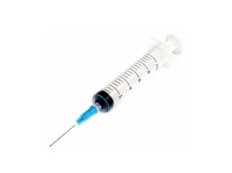

Concept of a disease (cont.)
After diagnosis, we need treatment.
There are two ways to stop the disease from spreading further
Treatment
Prevention
Cure
Relieve pain using painkillers
Vaccination
Using drugs or chemical to kill the pathogen

Slide 10
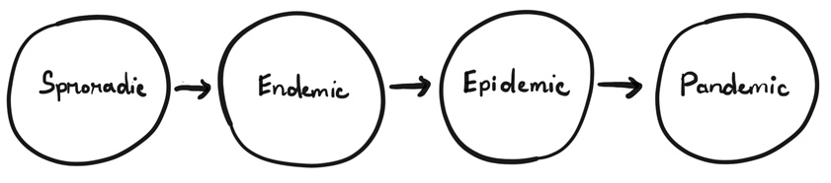
Overview of epidemics
Progress of a disease
When the occurrence of the disease is not regular and is infrequent, it is termed as sporadic.
When the presence of the disease is constant in a particular geographical area, it is known as endemic. Endemic turns into a hyperendemic situation when a high level of disease occurrence is observed.
When there is a sudden rise in the number of patients with the same disease and within a particular area, it is termed as an epidemic.
When epidemics affect larger geographical areas (including multiple countries and continents), it is known as a pandemic.

Slide 11
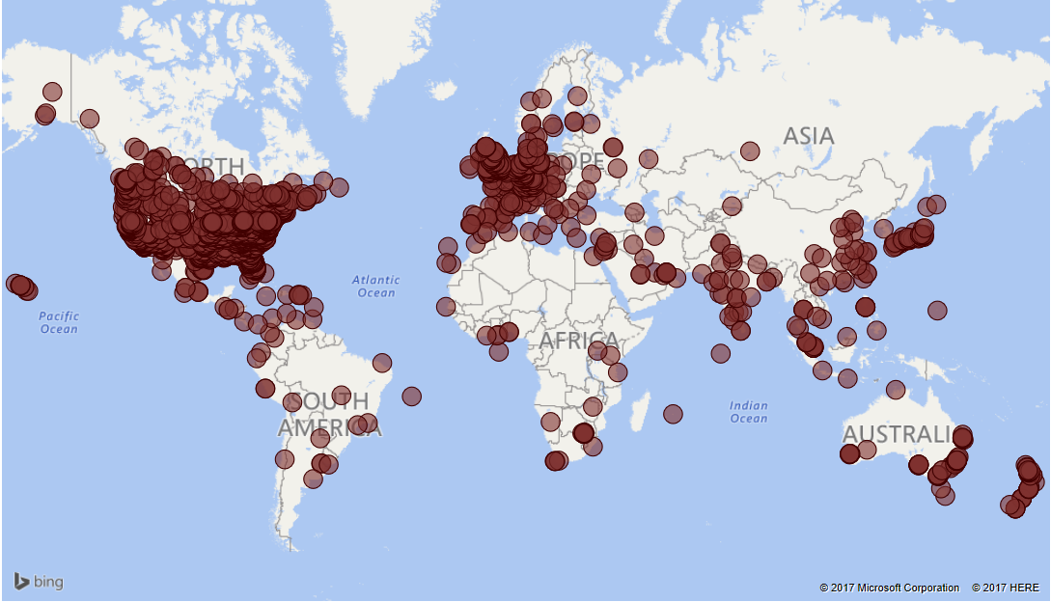
Overview of epidemics (cont.)
When the epidemic crosses local boundaries and at the same time affects a large geological area, it becomes a pandemic.

Slide 12

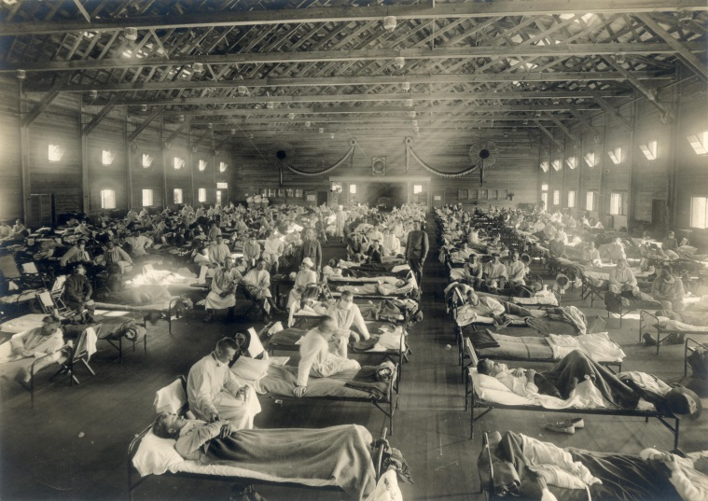
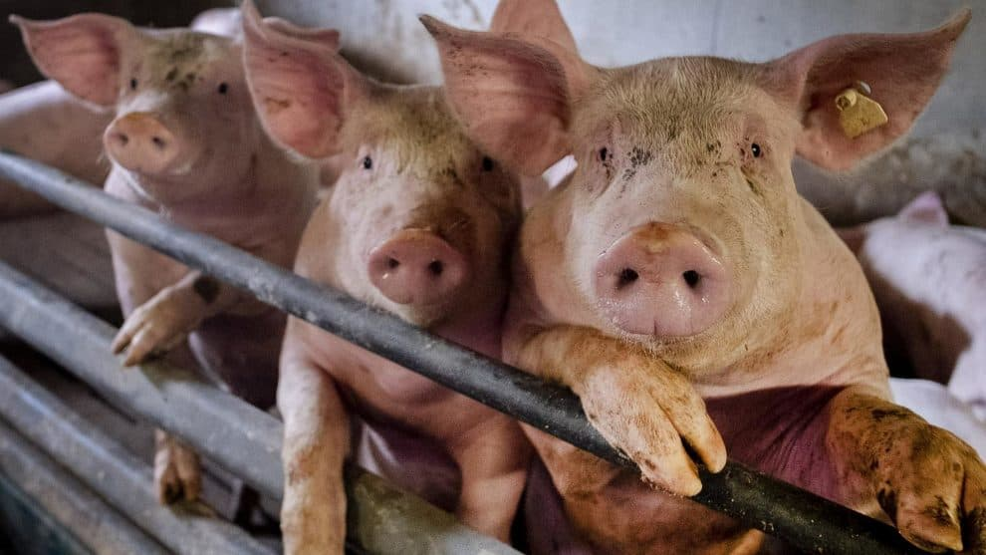
Overview of epidemics (cont.)
Some pandemics stand out in history because of the catastrophe they have caused.
Historical records indicate that these pandemics pose a serious threat to humanity.
Black Death pandemic (1347)
Spanish flu influenza (1918)
Swine flu influenza a.k.a H1N1 (2009)

Slide 13

Overview of epidemics (cont.)
The latest pandemic is the Coronavirus Disease 2019 (COVID-19), declared a pandemic by the World Health Organization (WHO) in January 2020.

Slide 14

The novel coronavirus
The word “novel” means “unknown” or “dealing with something new”.
From the beginning of the outbreak, extensive efforts are being demonstrated by scientists and experts all over the world.

Slide 15




The novel coronavirus (cont.)
COVID-19 has a zoonotic origin (transmitted from animals to humans).
Can spread through air droplets.
Wide range of symptoms: from asymptomatic to severe pneumonia.

Slide 16

The novel coronavirus (cont.)
The COVID-19 outbreak was an unprecedented situation that no one saw coming. Professionals and experts from different disciplines have to work together to find a solution.

Slide 17
02
Exploratory data analysis

Slide 18
This project focuses on analyzing data from July 1, 2020 to May 31, 2021 of three groups:
(i) Global
(ii) Three countries with highest confirmed cases: United States, Brazil, India
(iii) Three Asian countries: Japan, Korea, Vietnam

Slide 19
Object of observation
Confirmed
Deaths
Recovered
Case-fatality rate
Recovery rate
Mortality rate
In addition, we also takes into account factors such as
Population, Age group (of confirmed cases) and Stringency Index.

Slide 20
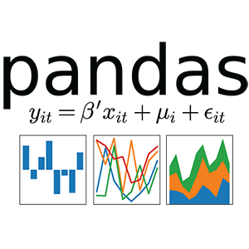
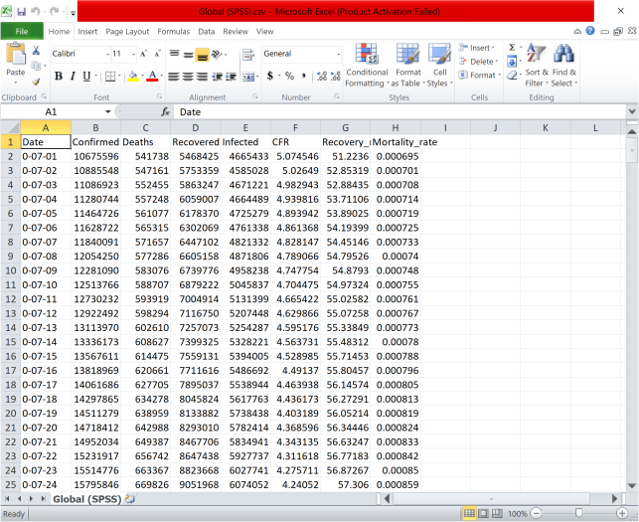


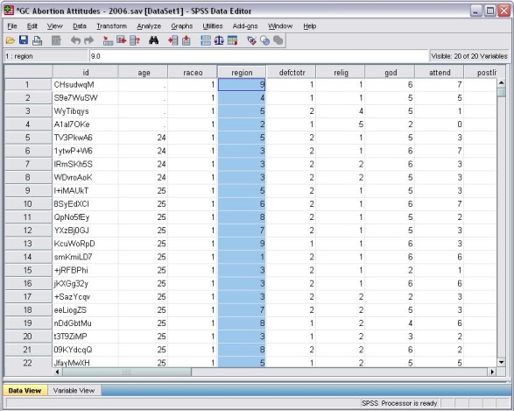
Libraries and tools
Excel
SPSS
Libraries (in Python)
Tools

Slide 21
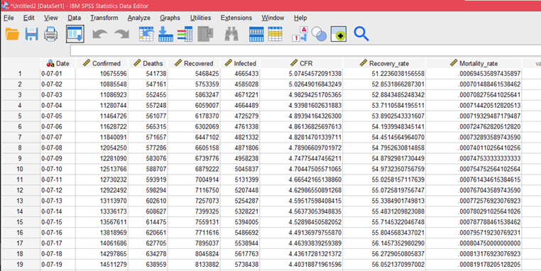
Data cleaning result
There are a total of seven separated data tables for seven regions examined, each with eight attributes (column): Date, Confirmed, Deaths, Recovered, Infected, Case-fatality rate (CFR), Recovery rate and Mortality rate, respectively. In which:
·Infected = Confirmed – Deaths – Recovered: Active cases
·Case-fatality rate = (Deaths / Confirmed) x 100: Rate of deaths over confirmed cases
·Recovery rate = (Recovered / Confirmed) x 100: Rate of recovered over confirmed cases
·Mortality rate = (Deaths / Population) x 100: Rate of deaths over a total population.
Time: from July 1, 2020 to May 31, 2021.
Dataset of Global with 8 attributes.

Slide 22
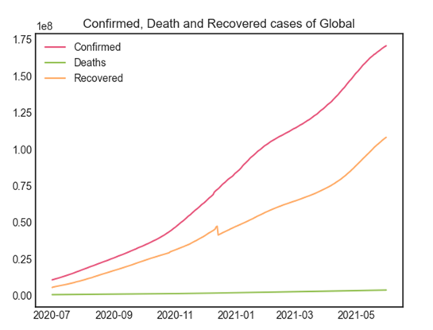
Basic visuals
The actual Confirmed number is higher because there may be asymptomatic patients.
Recovered’s line chart has a glitch towards the end of 2020 due to missing datas since December 14, 2020 of the United States (along with some other countries that were not included). It is probable that the US, which at the time has the largest number of confirmed cases in the world, was experiencing an unexpected outbreak making it difficult to keep track of cases.
Global Confirmed, Death and Recovered cases
(until May 31, 2021).

Slide 23
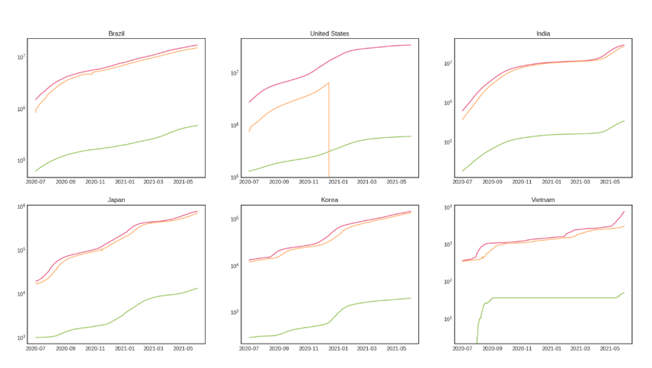
Basic visuals (cont.)
Except for United States, all figures show an upward trend that is almost linear.
As the Confirmed case increases, the number of confirmed cases increases, so does the Deaths rate with a similar ratio. In other words, if the Confirmed case saw a sharp increase, the Death case would be expected to also experience a drastic increase.
The Vietnam graph shows that the Confirmed cases were suddenly exploded from August 2020 to September 2020, causing Deaths cases to go up rapidly. Additionally, because there were not many previous Deaths cases in Vietnam, the Deaths line showed a strong exponential increase.
Confirmed, Death and Recovered cases of selected countries
(until May 31, 2021), on logarithm scale.

Slide 24
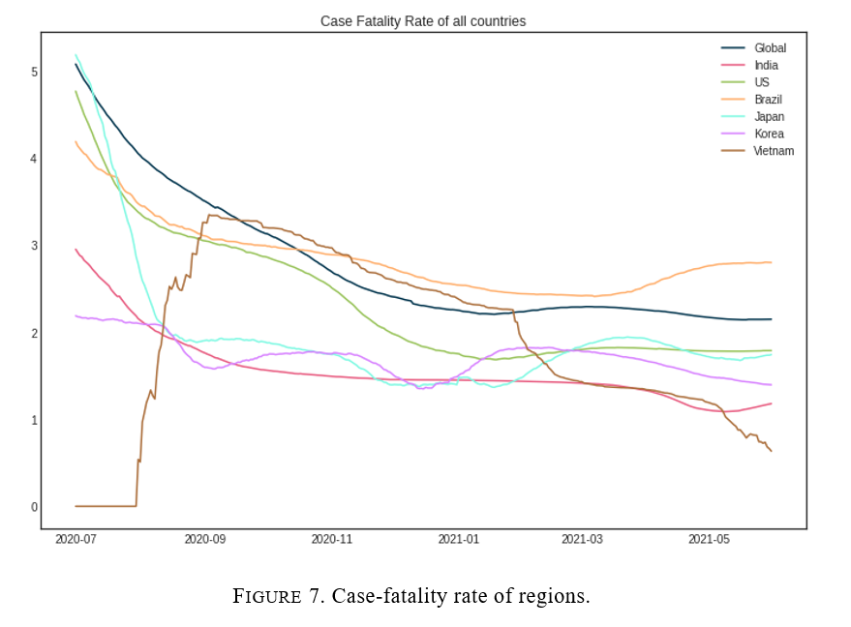
Basic visuals (cont.)
With the exception of Vietnam, the graphs show an exponential decay trend.
Before September of 2020, the Vietnam line chart was the only one that increased drastically while the others decreased. This is also when the Confirmed cases escalated, as mentioned. It is possible that the country was controlling the pandemic so well that its people lowered their guards, which allowed the disease to spread. However, from November 2020, it started to drop. And from February 2021, the line decreased rapidly, so Vietnam must have had the pandemic under control.
Case-fatality rate of regions

Slide 25
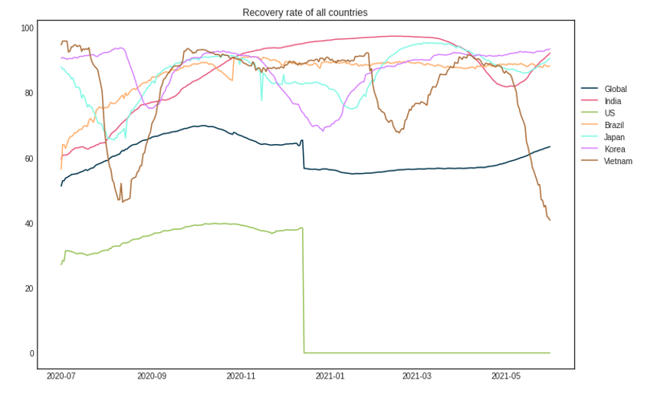
Basic visuals (cont.)
The general trend on this graph appears to be moving up and down around a stationary line.
Line graph of the United States is missing from December 14, 2020 onwards. US is the country with the highest number of Confirmed as well as Deaths globally. Hence, the US Recovery data should have a huge impact on global Recovered data trend.
Recovery rate of regions

Slide 26
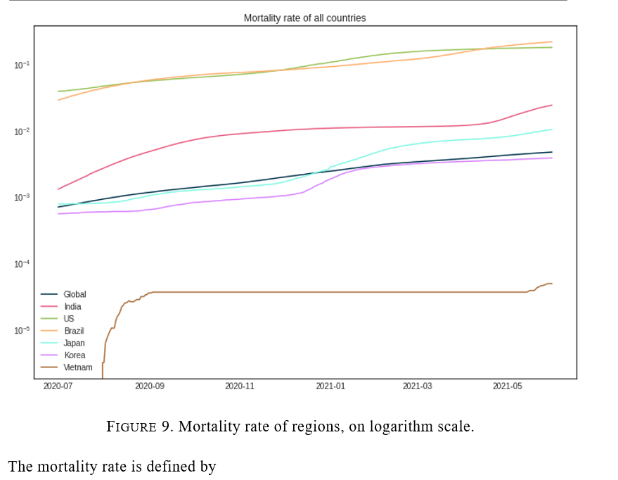
Basic visuals (cont.)
The graph shows that the rate is growing relatively smoothly, except for Vietnam which saw a sharp increase.
Even if only a small proportion of the population (0.01% - 0.2%) is lower than the mortality rate of people who die from other reasons (traffic accidents, other diseases), we still have to take into account that not all COVID-19 cases are recorded. As a result, it is still a dangerous disease and if we don't make efforts to control it, the death rate could rise exponentially to the point of loss of control.
Mortality rate of regions

Slide 27
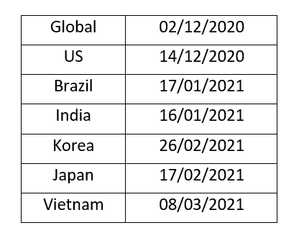
The table shows the date countries started mass vaccination. From the numbers and analyzes in the previous part, it can be seen that the numbers do not change significantly, even if vaccinations are already involved. The benefit is likely to come in the long run.
Starting date of vaccination by country.

Slide 28
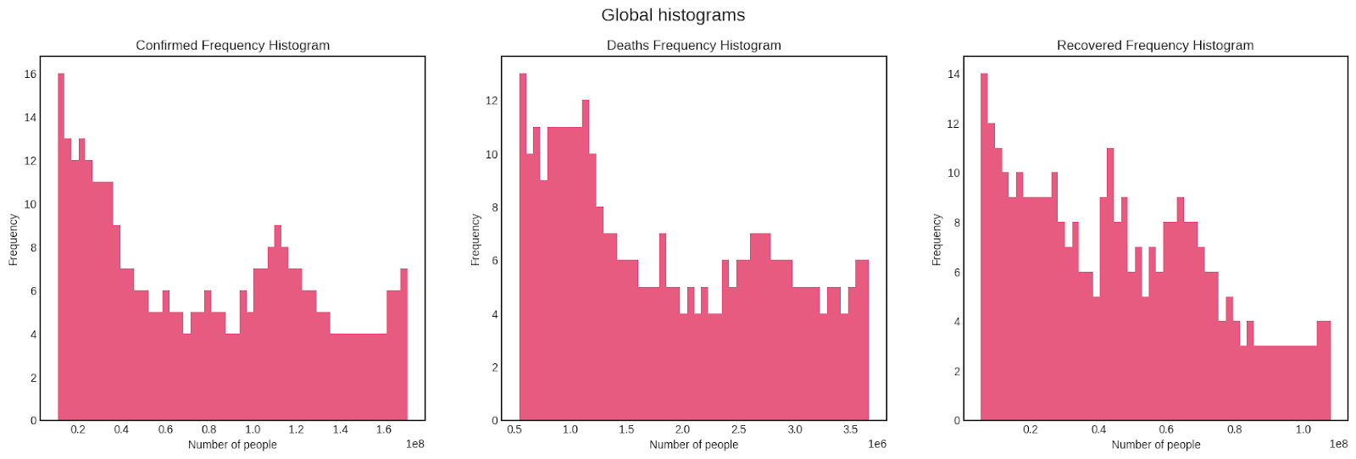
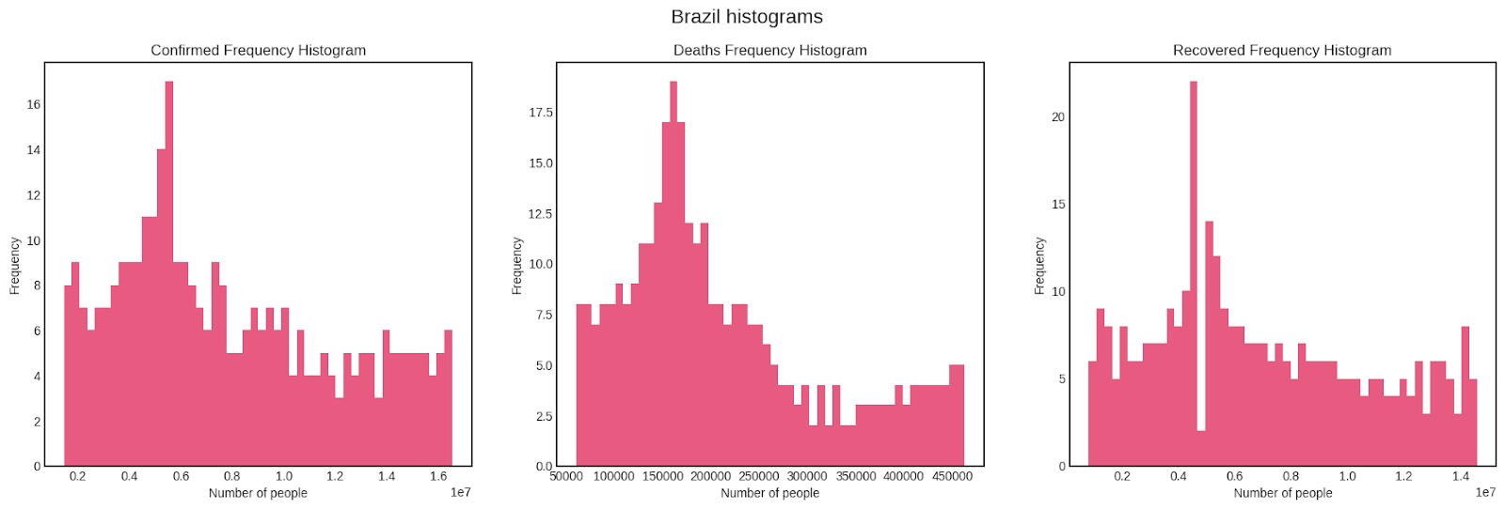
Data distribution
We observe the histograms created from recorded data of each region.
Global Confirmed, Death and Recovered frequency histograms. The Overall shape of three figures appear somewhat skewed to the right with several peaks (multimodal). This means the data tends to have lower values.
Global data
Confirmed, Death and Recovered frequency histograms of Brazil. All three graphs show the same trend of a right-skewed distribution.
Brazil data

Slide 29
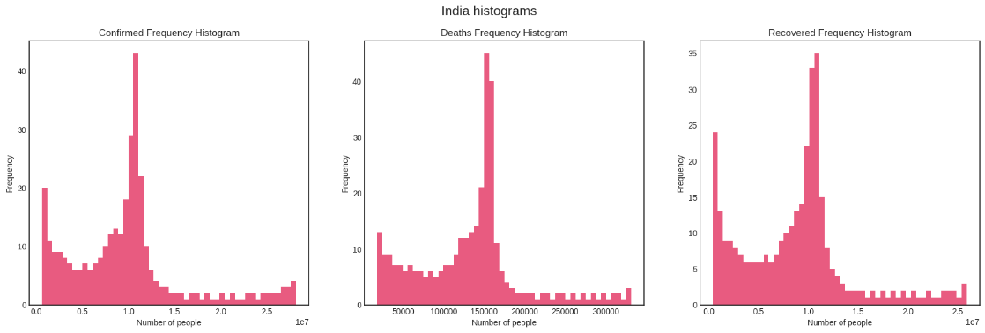
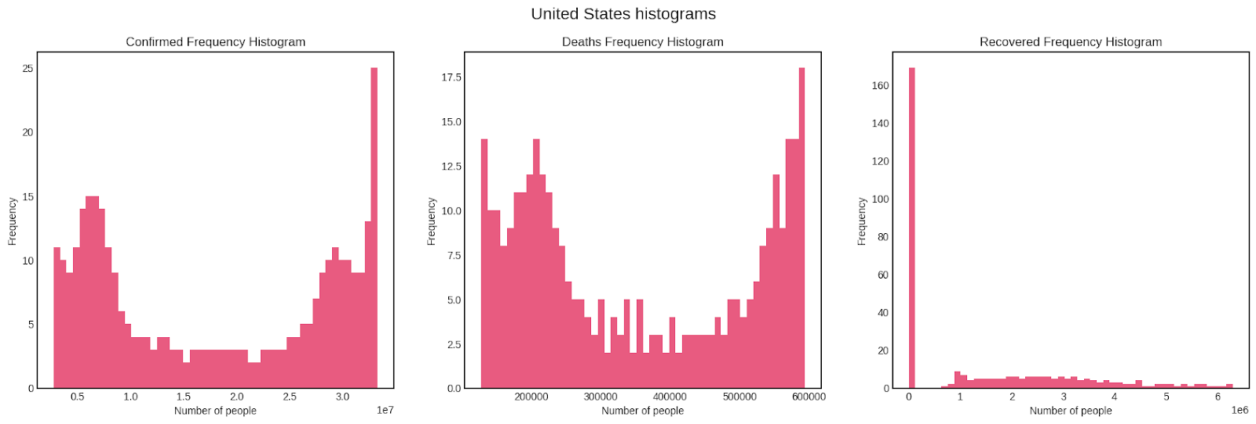
Data distribution (cont.)
Confirmed, Death and Recovered frequency histograms of India. The three plots closely follow the Laplace distribution with a large peak at the left end (edge peak).
India data
Confirmed, Death and Recovered frequency histograms of United States. The last graph seems randomly distributed, while the other two somewhat follow the dog food distribution – meaning the data tends to split into two clusters at either ends, creating a large gap in between remains.
US data

Slide 30
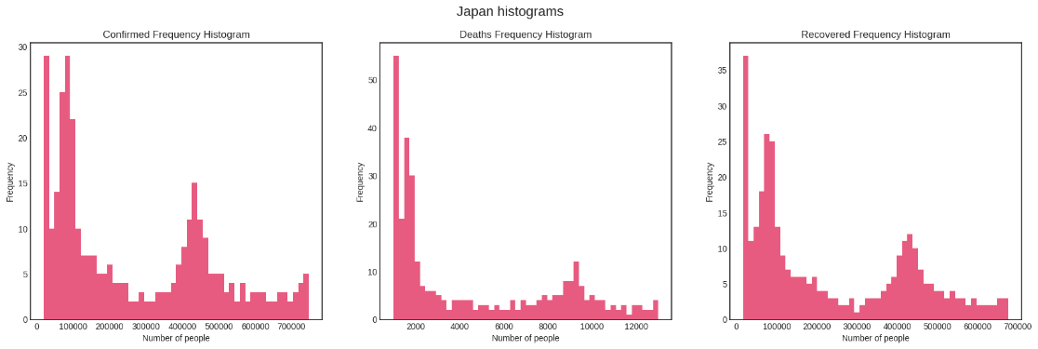
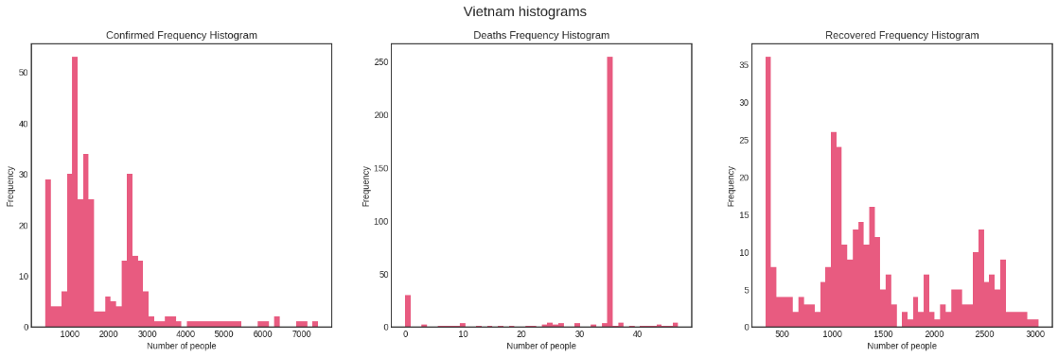
Data distribution (cont.)
Confirmed, Death and Recovered frequency histograms of Japan. All graphs show multimodal right-skewed distribution.
Japan data
Confirmed, Death and Recovered frequency histograms of Vietnam. Data appear as random distribution as Vietnam has little information compared to others countries.
Vietnam data

Slide 31
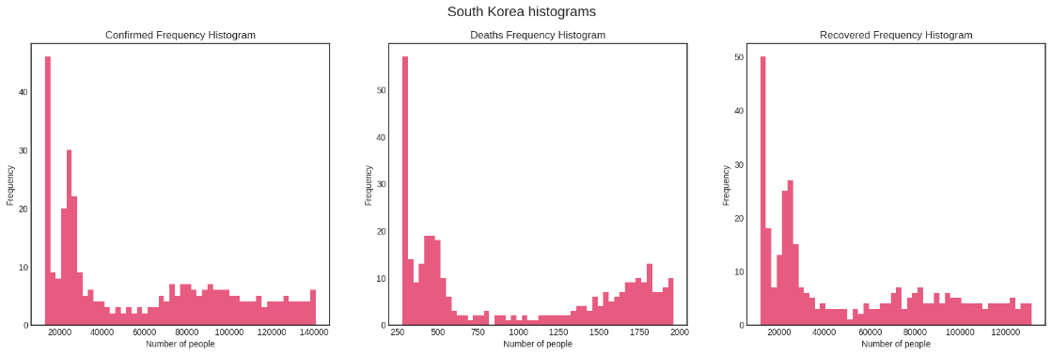
Data distribution (cont.)
South Korea data
Confirmed, Death and Recovered frequency histograms of South Korea. The first and last graphs have the same shape of a right-skewed trend with a small elevation, while Deaths histogram somewhat follow the dog food distribution – meaning the data tends to split into two clusters at either ends, creating a large gap in between remains.

Slide 32
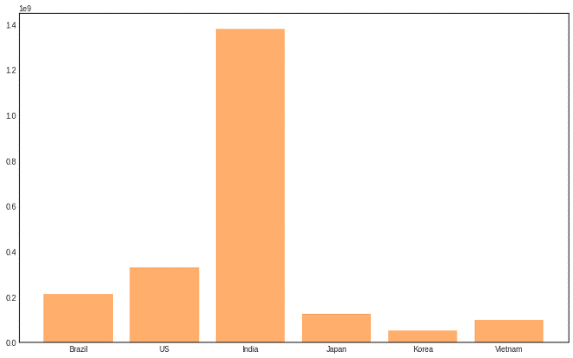
Custom visuals
+Population:
population density levels at the county level can increasingly explain the variation of cumulative cases across counties as the epidemic progressed.
Population of studied countries

Slide 33
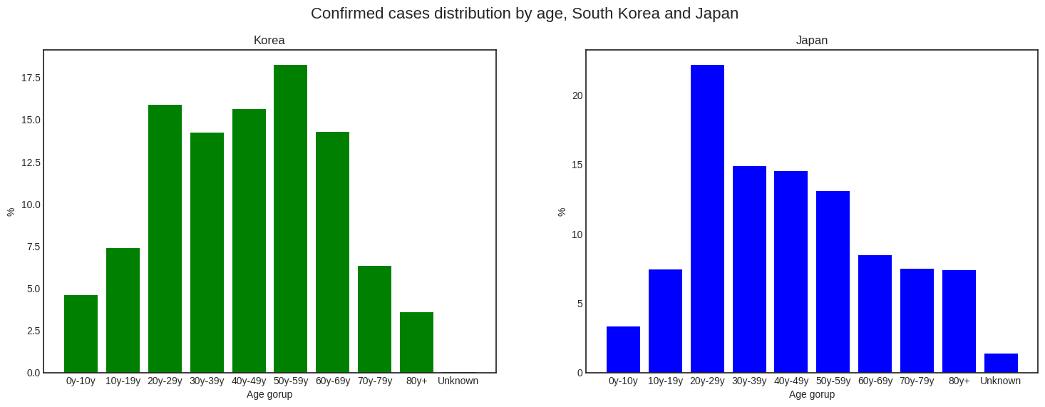
Custom visuals (cont.)
+Confirmed cases by age distribution:
The graph of South Korea distributed normally. Most of the confirmed cases of Korea range from 20 to 59, while Japan has a surprisingly high number of 20s people diagnosed. The distribution of Japan is right-skewed.
Several factors like Social activities demand, romantic demand or psychology factor might explain why more younger people in Japan are likely to catch the virus, while in the case of Korea, 20-59 is common working age. Participating in daily activities may put people at a higher risk of developing serious routes of infection.
Confirmed cases distribution by age of South Korea and Japan

Slide 34
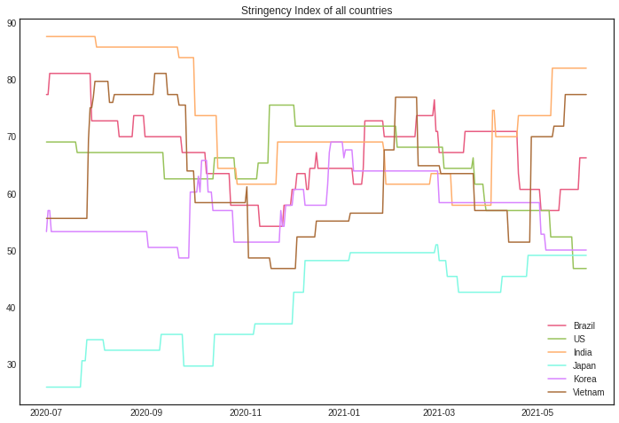
Custom visuals (cont.)
Stringency index is a composite score developed by researchers at Oxford University to compare countries’ policy responses to the COVID-19 pandemic.
As can be seen from the graphic and the previous sections, countries with the higher case numbers tend to have a higher stringency index. The response of governments to the COVID-19 situation is important to keep the pandemic under control.
Stringency index of studied countries

Slide 35
03
SIR Model terminology 101

Slide 36
To understand the key elements affecting the transmission of COVID-19, we consider developing a predictive model. One of the most well-known models in epidemiology is SIR.

Slide 37
1. From basic exponential growth
to the famous curves set
A person who contains the virus is called Infected, and others who are not infected but still have a percentage of chance to catch the virus spread by the Infected is called Susceptible. Infectious people can turn Susceptible people into more Infectious people.
In a very simple scenario, for example, let’s say each Infected can infect two Susceptible, means that after some fixed interval of time, 1 Infected will become 2, 2 will become 4, 4 will become 8...and so on; starting with only 1 of the population being Infected and without any extra external factors, here is what the infection graph would look like:

Slide 38
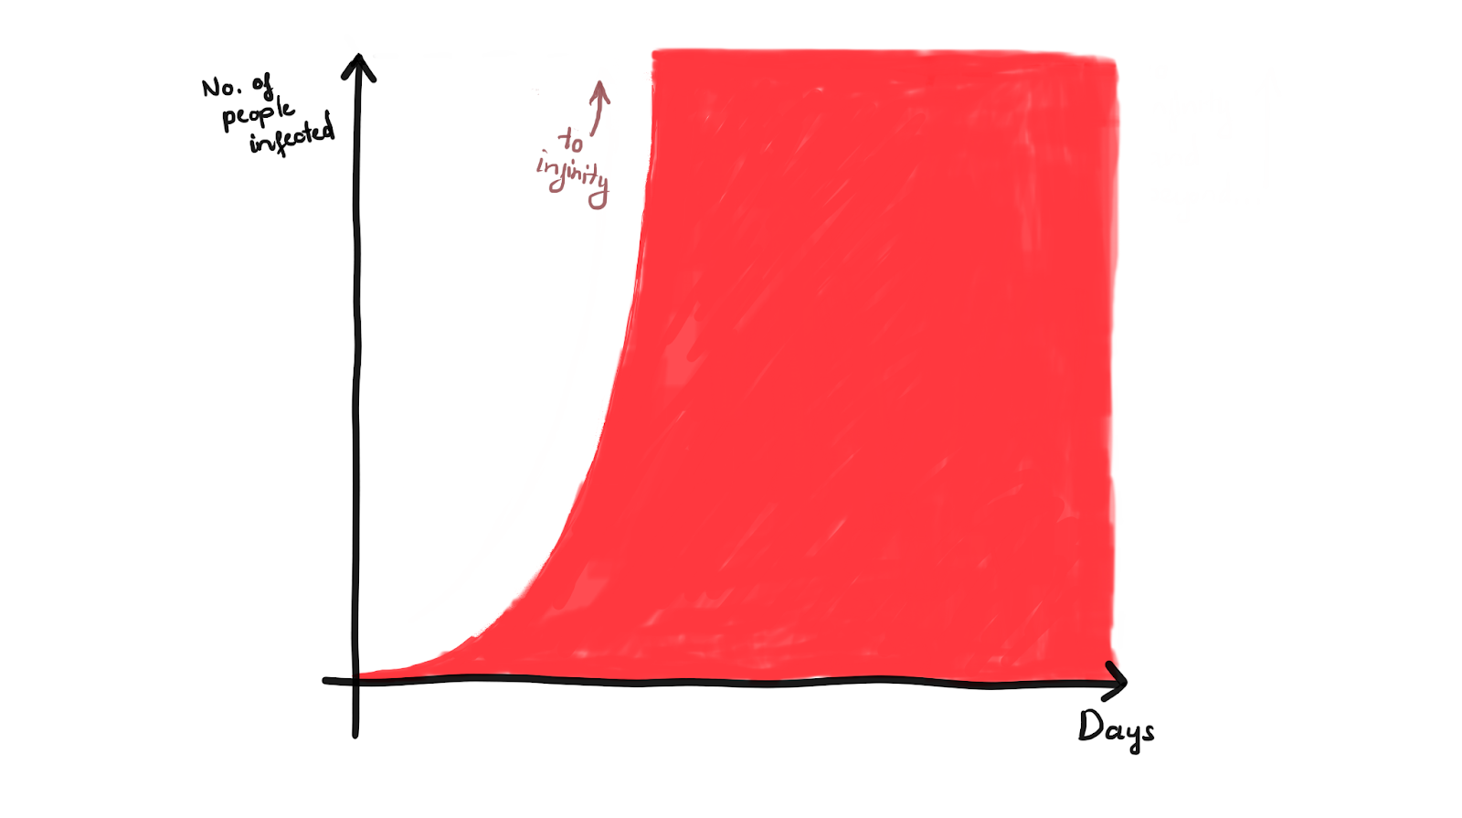
From basic exponential growth
to the famous curves set (cont.)
This trend follows the basic exponential growth,
starts low then unexpectedly blows up to infinity.

Slide 39
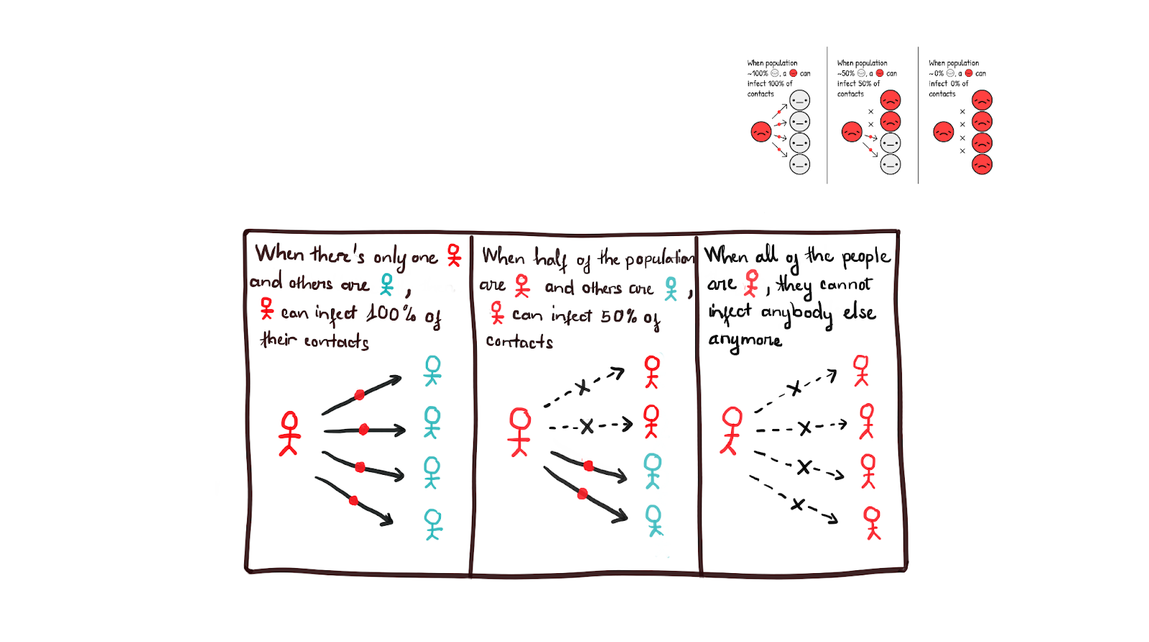
From basic exponential growth
to the famous curves set (cont.)
Thankfully, this is definitely not happening in real life. Since the human population is fixed, the trend cannot go on forever. The idea is:
In that sense, the more Infecteds there are, the faster Susceptibles become Infecteds; but, the fewer Susceptibles there are, the slower Susceptibles become Infecteds.

Slide 40
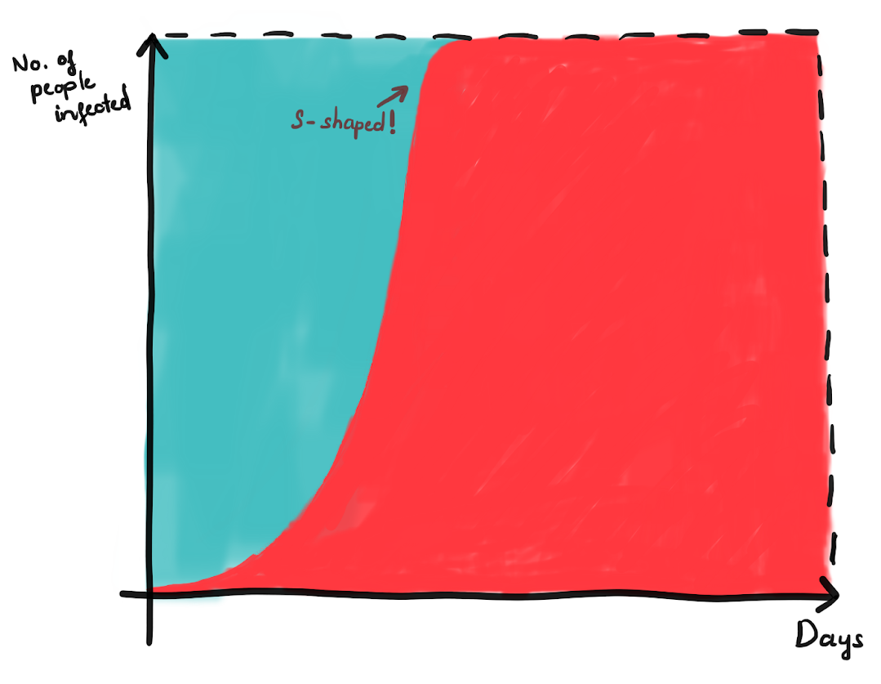
From basic exponential growth
to the famous curves set (cont.)
The graph of epidemic growth is now changed:
This is called the logistic growth curve:
starts low, blows up, then slows down once again.

Slide 41
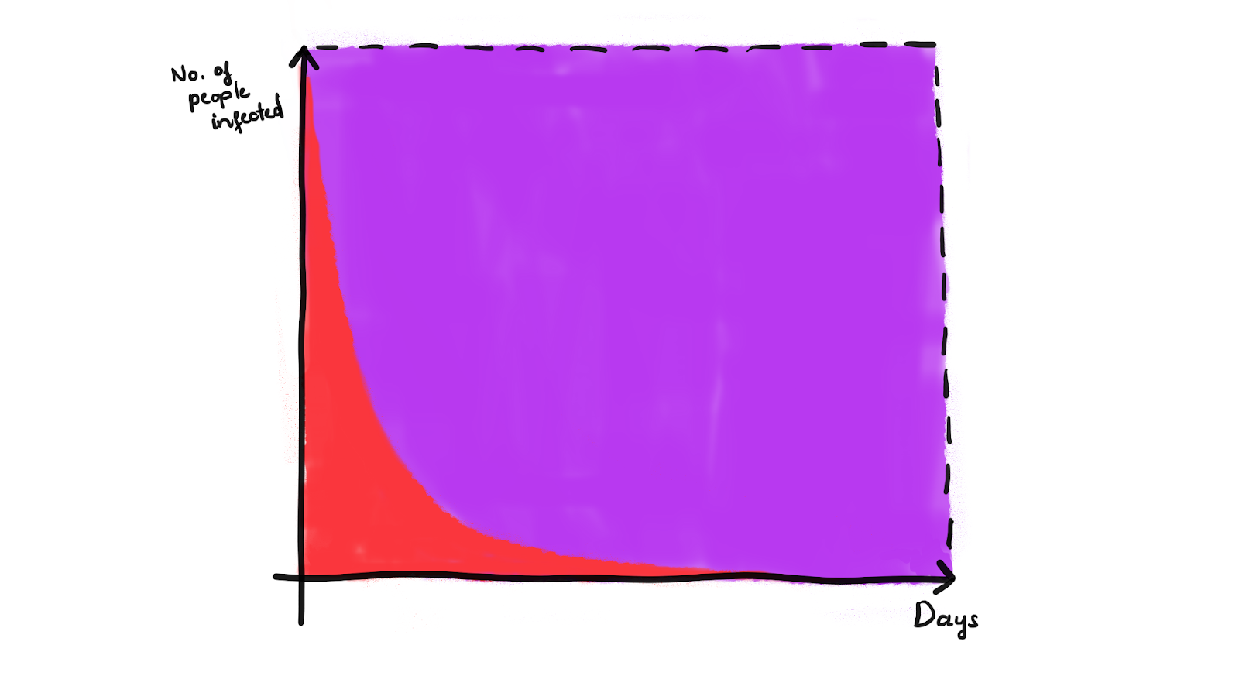
From basic exponential growth
to the famous curves set (cont.)
However, the concept is still not applicable. In reality, when the Infected stops being infectious, that means: either they are 1/ recovered (and healthy), 2/ immune to the virus but left with permanent disabilities, or in the worst case, 3/ dead. Now, for the sake of simplicity, we pretend that all Infected become Recovered, and they never be infected again.
Assume that Infected + Recovered = fixed number. The change of Infected and Recovered with respect to each other is simulated below:
This seems opposite of the above exponential growth - the exponential decay curve.

Slide 42
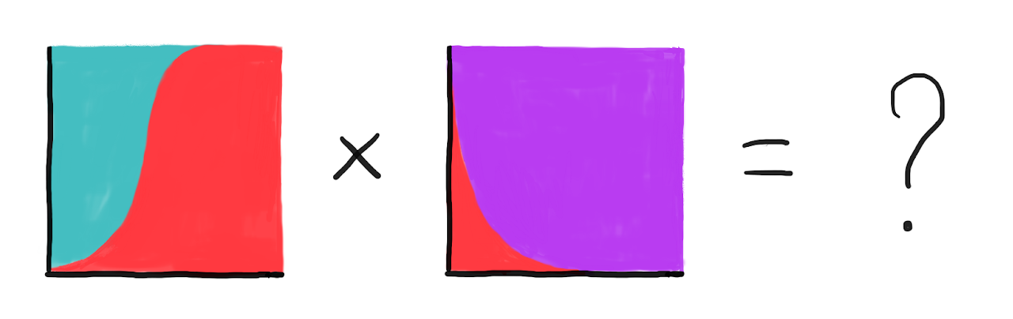
From basic exponential growth
to the famous curves set (cont.)
Now, what if we simulate the S-shaped logistic growth (Infected-Susceptible)
with decay curve (Infected-Recovery)?

Slide 43
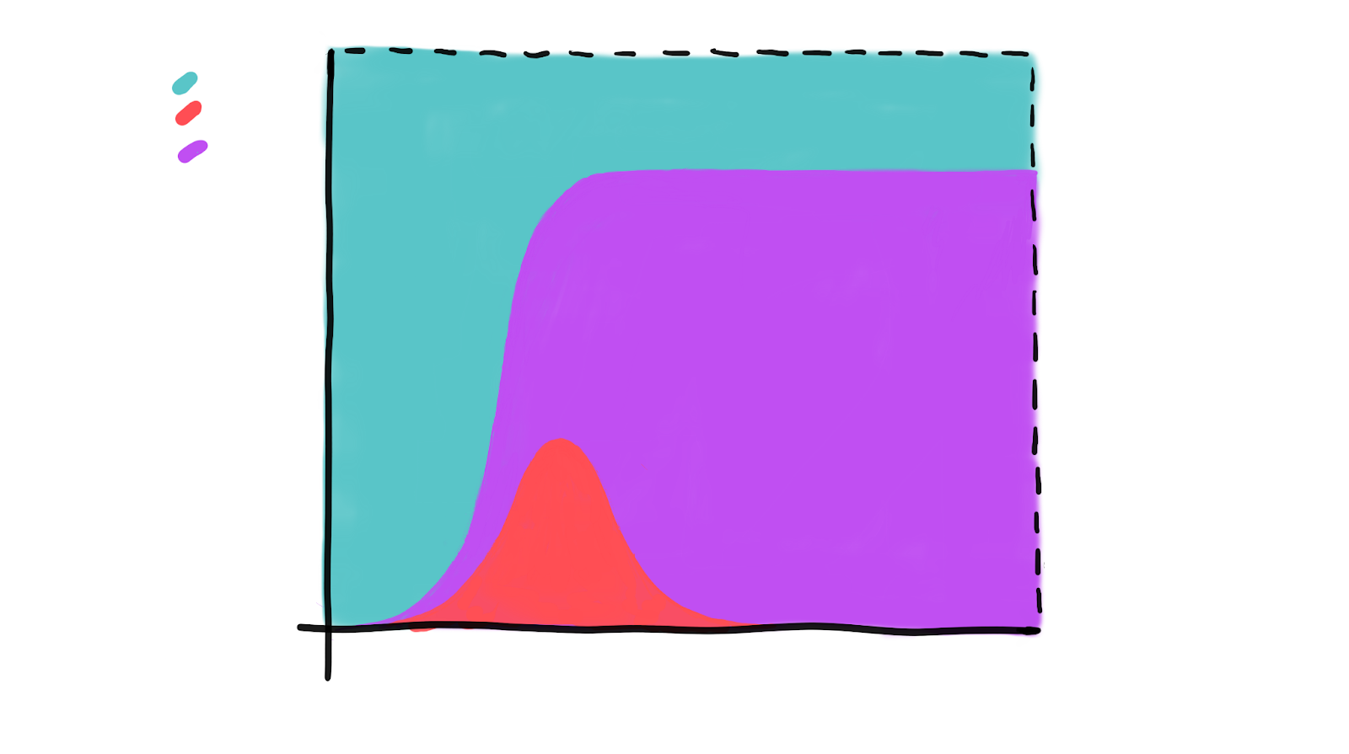
From basic exponential growth
to the famous curves set (cont.)
Here it is:
This set of curves is actually an important and common mathematical model
in data analytics - the SIR Model (Susceptible - Infected - Recovered).

Slide 44
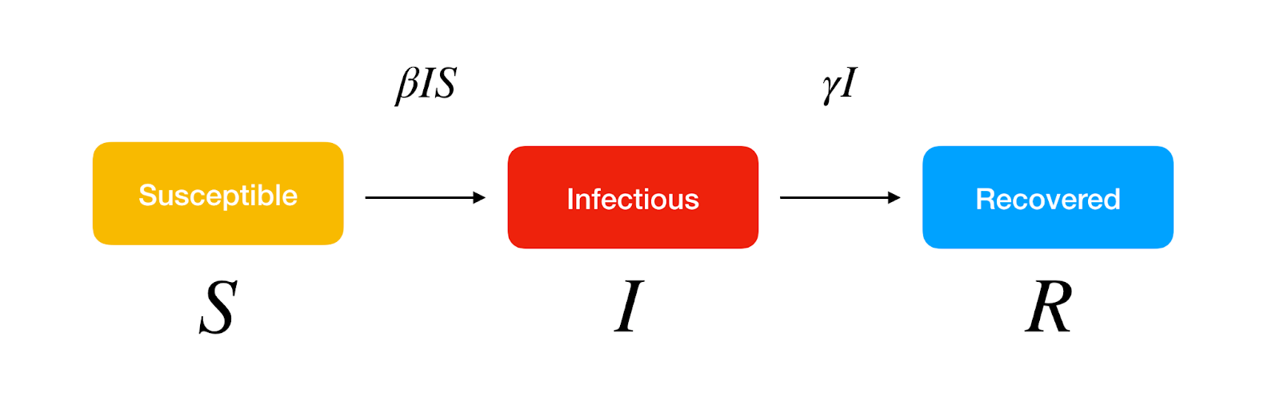
SIR Model
SIR model divides a fixed population of N people into 3 compartments:
Susceptible (S): The individual has not contracted the disease, but can be infected due to transmission from infected people.
Infected (I): The individual has contracted the disease.
Recovered (R): The individual has survived and developed immunity to the disease or is deceased.

Slide 45
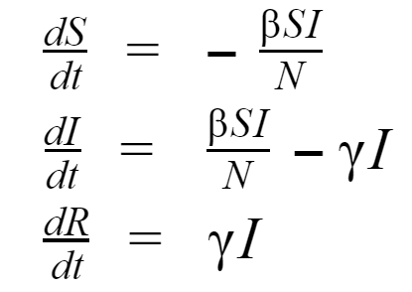
SIR Model (cont.)
Consider that people develop immunity and there is no transition from recovered to the remaining 2 stages, the differential equations that govern the system are:
With β is the effective contact rate of the disease and γ is the mean recovery rate. The SIR model is one of the simplest compartmental models whose main purpose is to understand the key factors that impact the epidemic transmission, which, in this case, is β and γ.

Slide 46
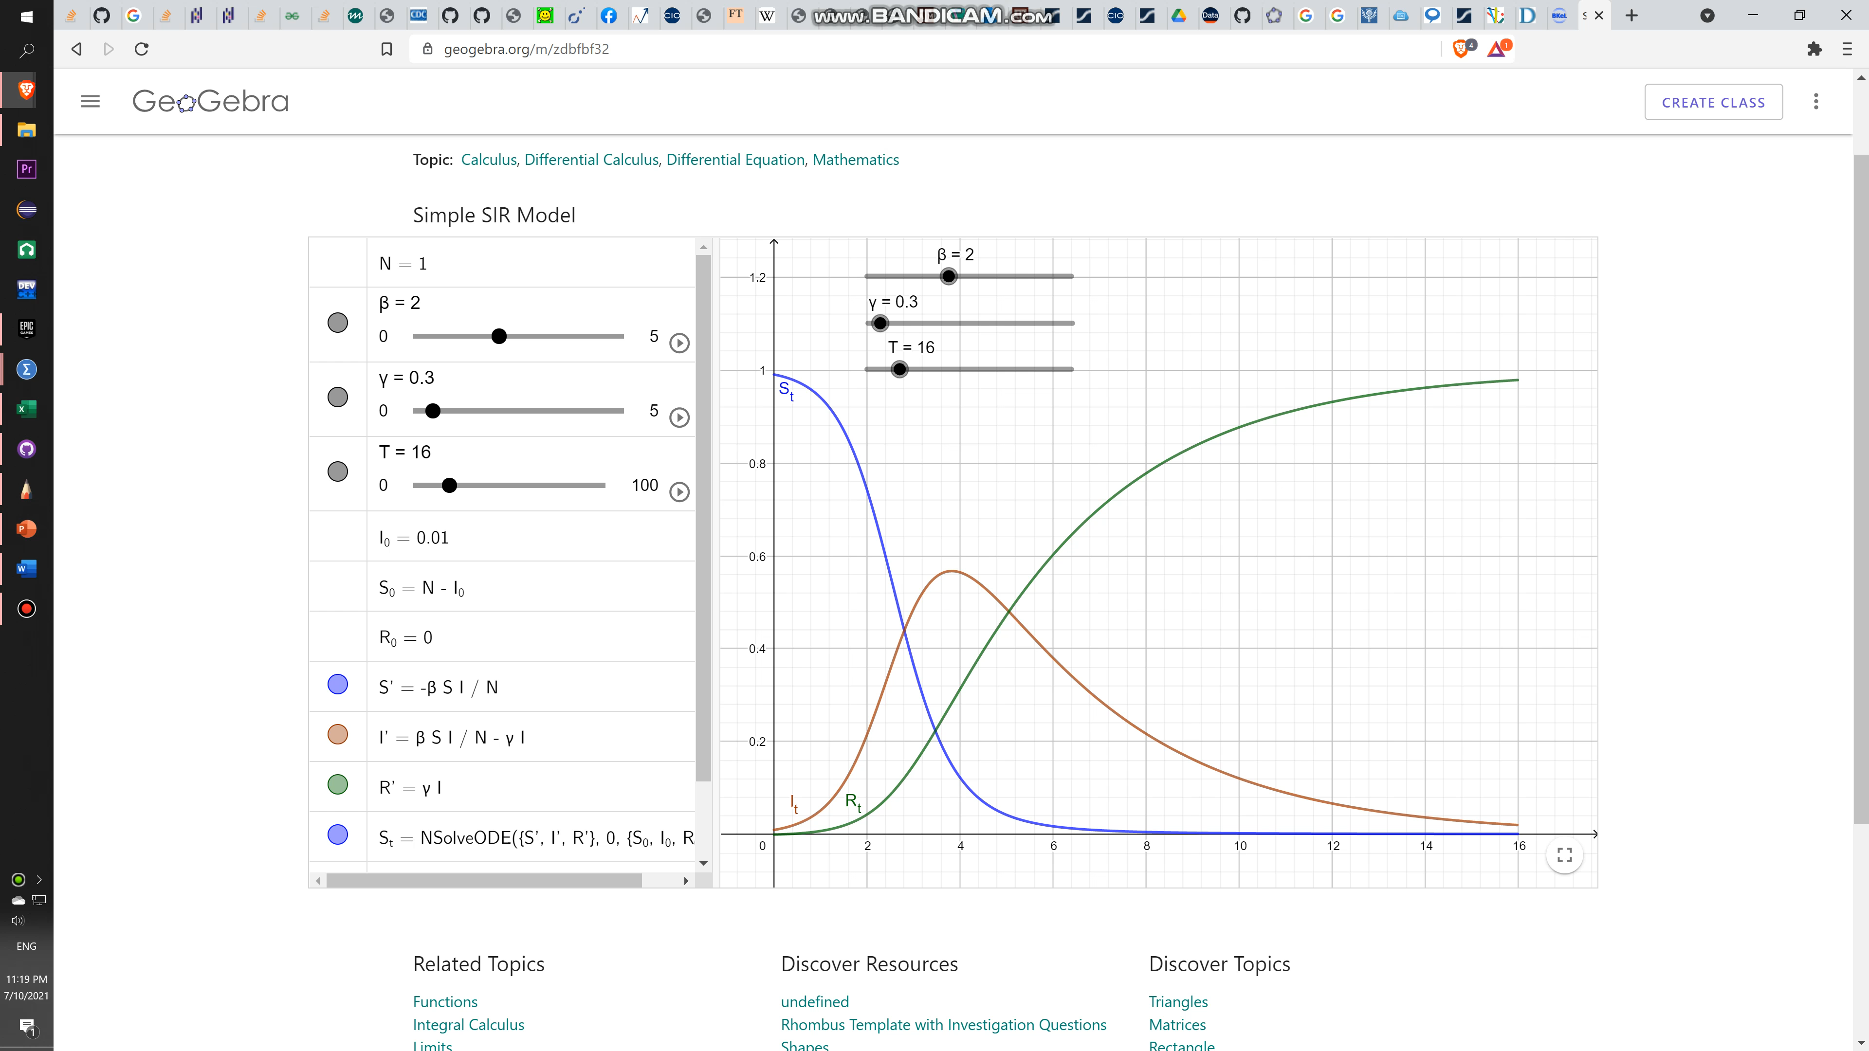
SIR Model (cont.)
The result changes based on the change of beta and gamma.

Slide 47
SIR Model (cont.)
With the aim of understanding the effects of the parameter selection for the SIR compartment model, a total of nine diagrams are presented for each country with a variation of the γ and β parameters.
First, a fixed γ = 0.2 is selected and the three different values for β are considered: β = [1, 2, 3].The same process is then repeated for γ = 0.1 and γ = 0.066.

Slide 48
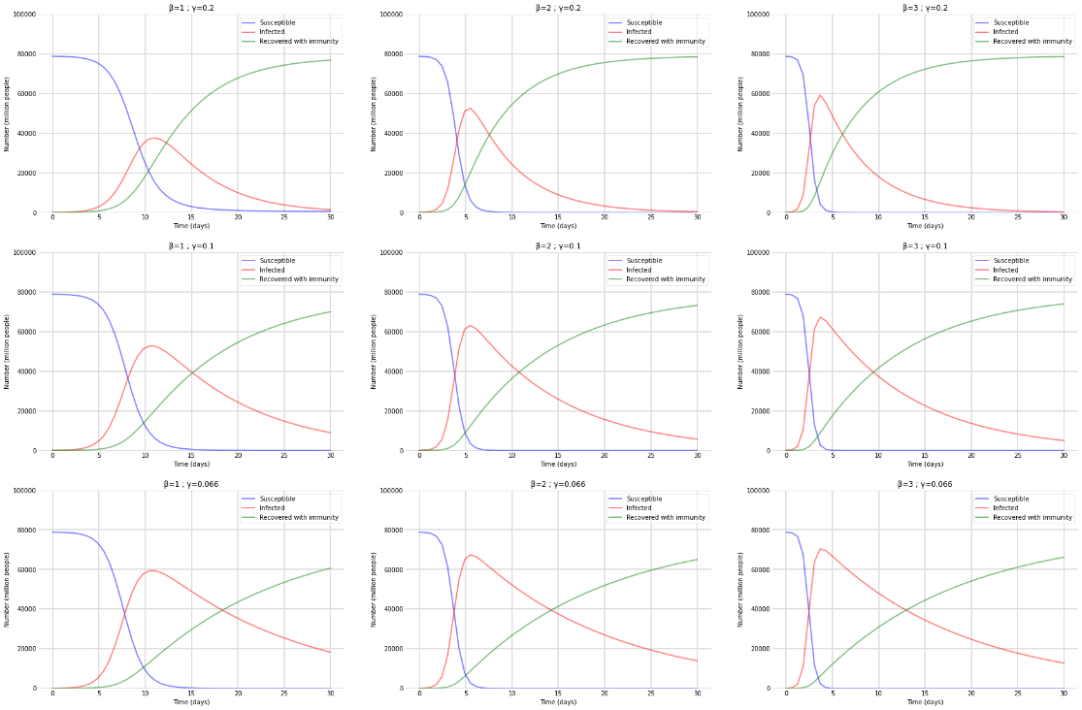
SIR Model (cont.)
Results for Global: Prediction based on the SIR model considering the variation of the parameters γ and β. Figures a, b, and c has γ = 0.2 and β = [1, 2, 3], respectively. Figures d, e, and f has γ = 0.1 and β = [1, 2, 3], respectively. Figures g, h, and i γ = 0.066 and β = [1, 2, 3], respectively.

Slide 49
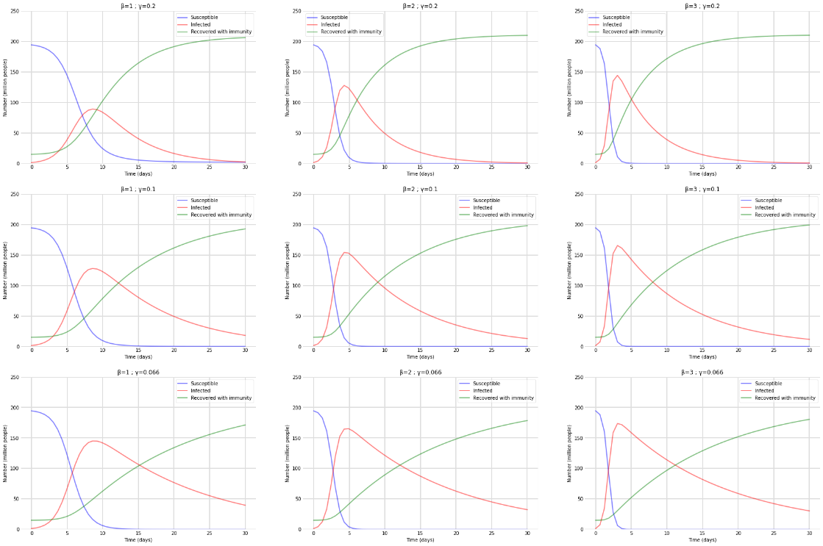
SIR Model (cont.)
Results for Brazil: Prediction based on the SIR model considering the variation of the parameters γ and β. Figures a, b, and c has γ = 0.2 and β = [1, 2, 3], respectively. Figures d, e, and f has γ = 0.1 and β = [1, 2, 3], respectively. Figures g, h, and i γ = 0.066 and β = [1, 2, 3], respectively.

Slide 50
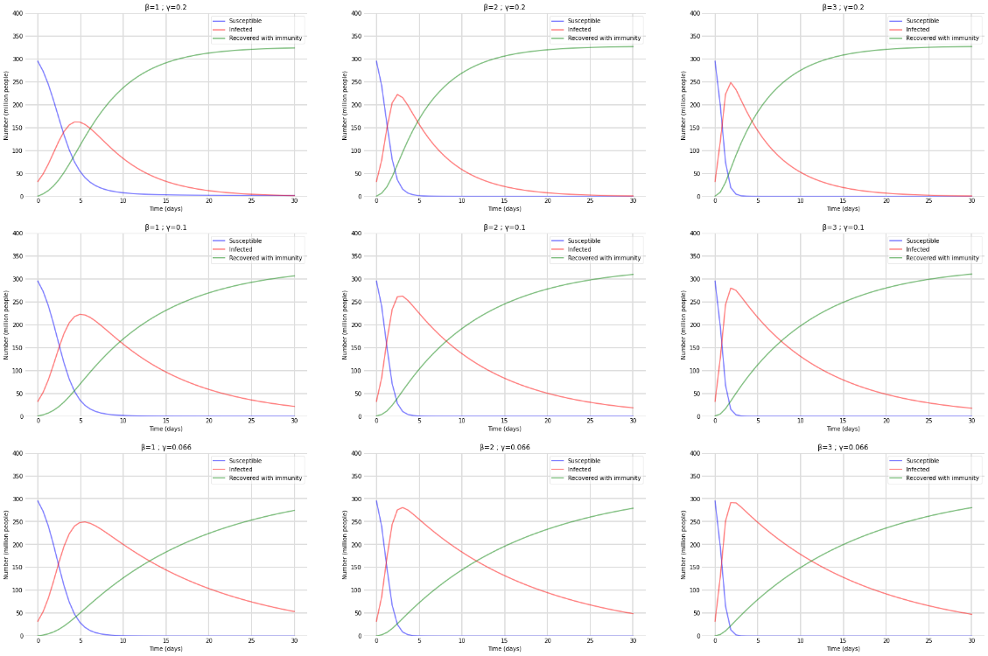
SIR Model (cont.)
Results for United States: Prediction based on the SIR model considering the variation of the parameters γ and β. 1st, 2nd and 3rd figures has γ = 0.2 and β = [1, 2, 3], respectively. 4th, 5th and 6th figures has γ = 0.1 and β = [1, 2, 3], respectively. Figures 7th, 8th and 9th has γ = 0.066 and β = [1, 2, 3], respectively.

Slide 51
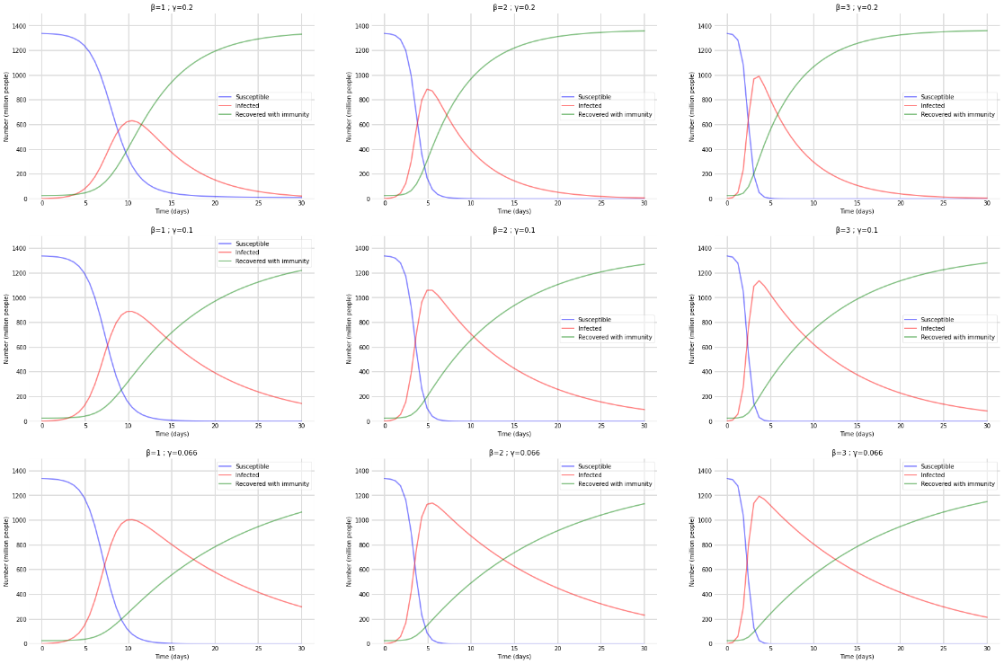
SIR Model (cont.)
Results for India: Prediction based on the SIR model considering the variation of the parameters γ and β. 1st, 2nd and 3rd figures has γ = 0.2 and β = [1, 2, 3], respectively. 4th, 5th and 6th figures has γ = 0.1 and β = [1, 2, 3], respectively. Figures 7th, 8th and 9th has γ = 0.066 and β = [1, 2, 3], respectively.

Slide 52
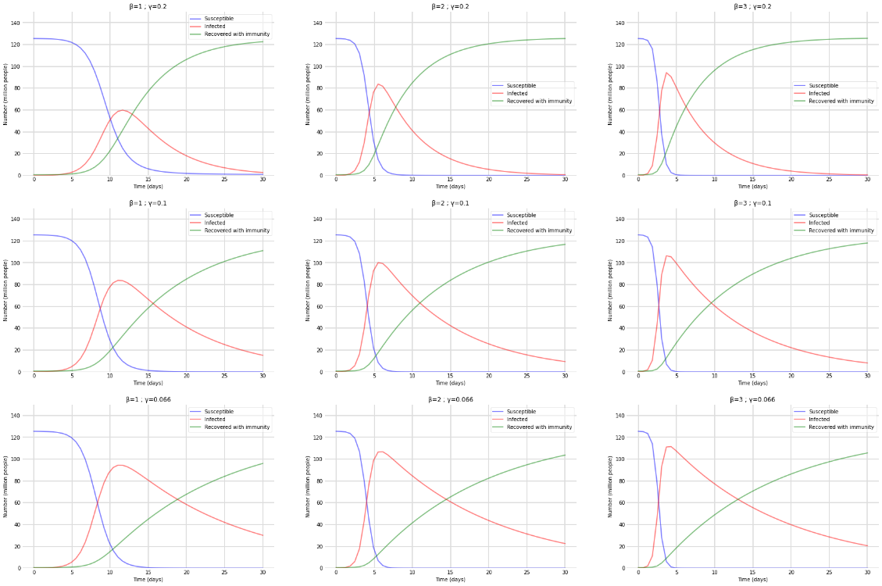
SIR Model (cont.)
Results for Japan: Prediction based on the SIR model considering the variation of the parameters γ and β. 1st, 2nd and 3rd figures has γ = 0.2 and β = [1, 2, 3], respectively. 4th, 5th and 6th figures has γ = 0.1 and β = [1, 2, 3], respectively. Figures 7th, 8th and 9th has γ = 0.066 and β = [1, 2, 3], respectively.

Slide 53
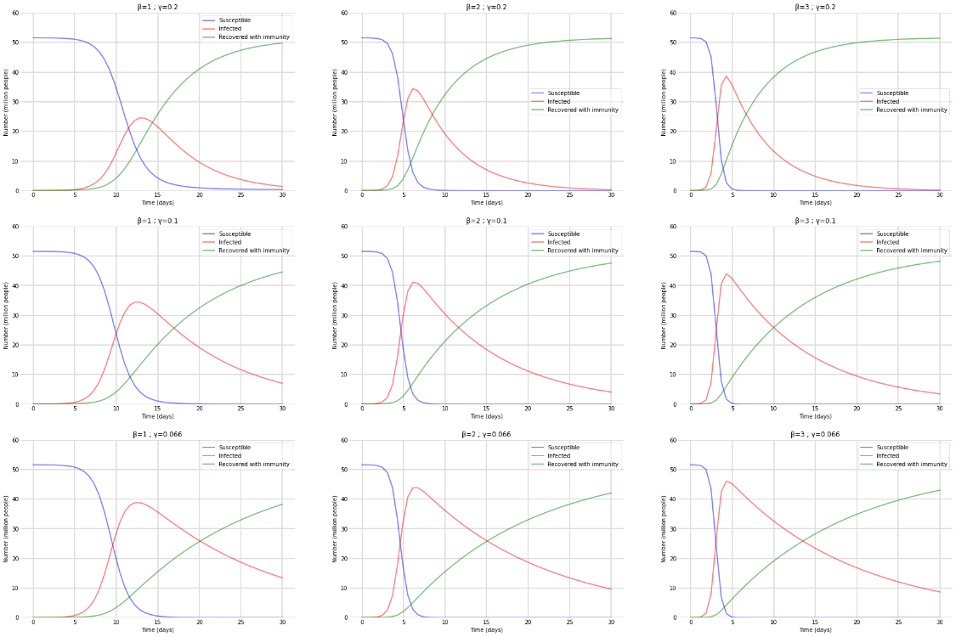
SIR Model (cont.)
Results for South Korea: Prediction based on the SIR model considering the variation of the parameters γ and β. Figures a, b, and c has γ = 0.2 and β = [1, 2, 3], respectively. Figures d, e, and f has γ = 0.1 and β = [1, 2, 3], respectively. Figures g, h, and i γ = 0.066 and β = [1, 2, 3], respectively.

Slide 54
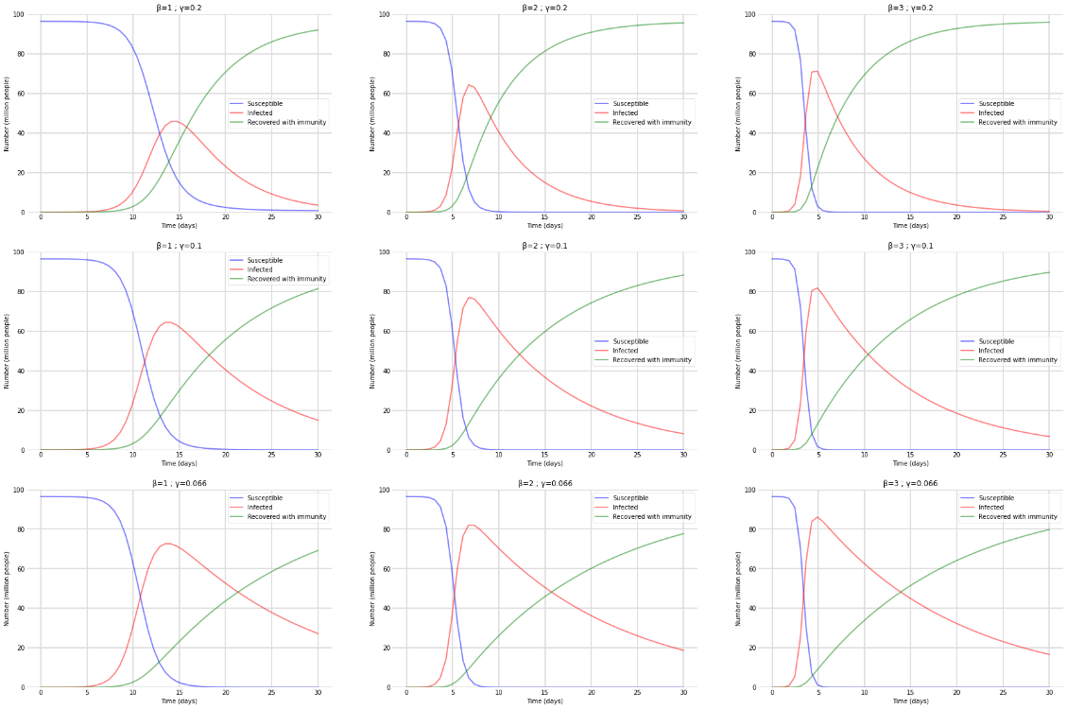
SIR Model (cont.)
Results for Vietnam: Prediction based on the SIR model considering the variation of the parameters γ and β. Figures a, b, and c has γ = 0.2 and β = [1, 2, 3], respectively. Figures d, e, and f has γ = 0.1 and β = [1, 2, 3], respectively. Figures g, h, and i γ = 0.066 and β = [1, 2, 3], respectively.

Slide 55
Observation of SIR Model
At the start of the period, the number of infected individuals increases if β > γ and vice versa.
The number of susceptible individuals decreases over time.
The number of infected individuals reaches a peak, then decreases over time. This occurs sooner as the parameter β increases.
All compartments flatten out after a period of time, which occurs sooner as the parameter γ increases.
The number of recovered or deceased individuals increases more or less significantly as the number of infected individuals increases or decreases respectively.

Slide 56
04
Machine learning in COVID-19 prediction

Slide 57
The aim of these models is to predict is the number of infected (or active) cases of COVID-19.

Slide 58

Random Forest Regression (RFR) model
Random Forest Regression (RFR) is a supervised learning algorithm that uses ensemble learning methods for regression. Ensemble learning method is a technique that combines predictions from multiple machine learning algorithms to make a more accurate prediction than a single model.
RFR splits the dataset into a number of trees, then repeats the process in each tree for a number of times or until all leaves are pure (all data points contain the same label). Then it takes in all of the output of the trees to form a final result.

Slide 59
RFR pre-proposed method
RFR requires an input value and an output value in order to function. First step is to convert our time-series dataset into a monitored learning dataset.
To predict the value for the last 14 days, the model will predict the next day's data from the values ​​for the last known 6 days, then add the forecast to the data set and repeat the process for a total of 14 times.
The results were organized in the following sequence: Global, Brazil, United States, India, Japan, South Korea, Vietnam.

Slide 60
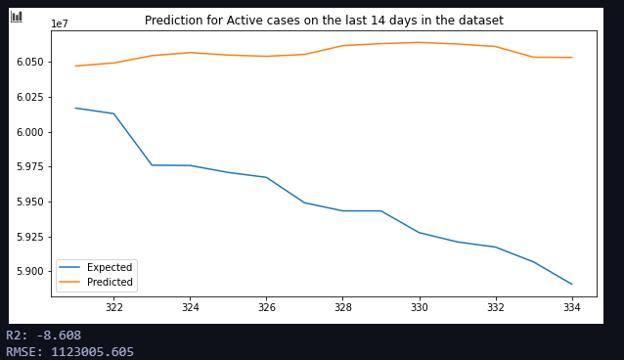
Training results
Global

Slide 61
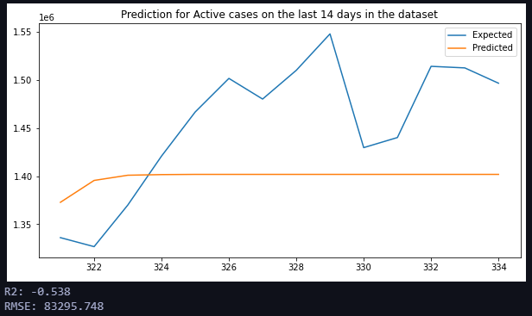
Training results (cont.)
Brazil

Slide 62
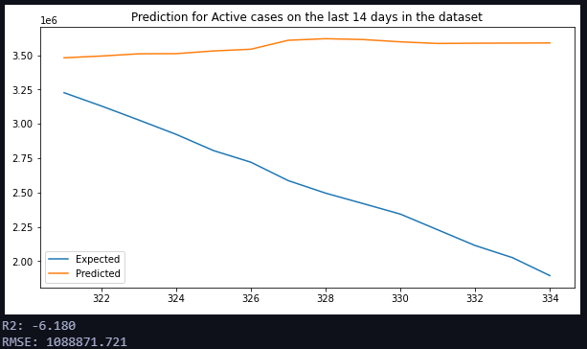
Training results (cont.)
India

Slide 63
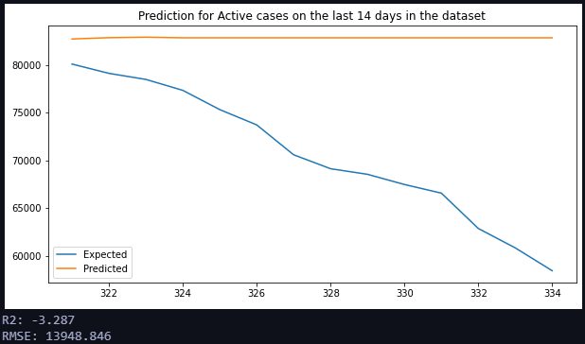
Training results (cont.)
Japan

Slide 64
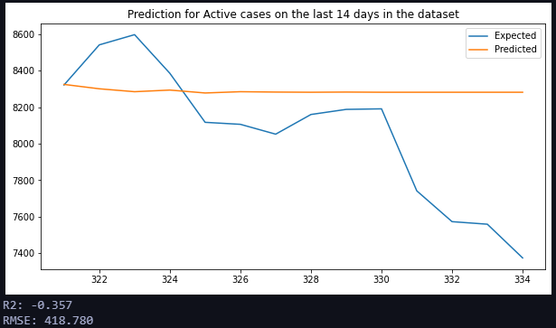
Training results (cont.)
South Korea

Slide 65
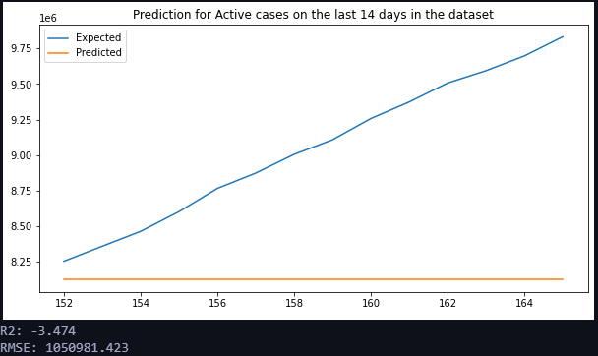
Training results (cont.)
US

Slide 66
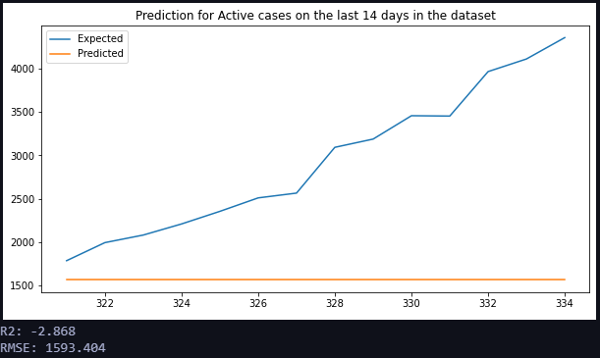
Training results (cont.)
Vietnam

Slide 67
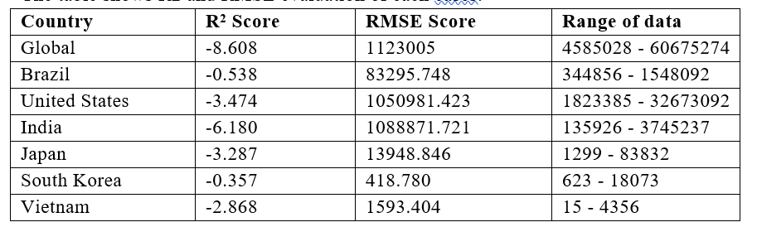
Training results (cont.)
The table shows R2 and RMSE evaluation of each cases.

Slide 68
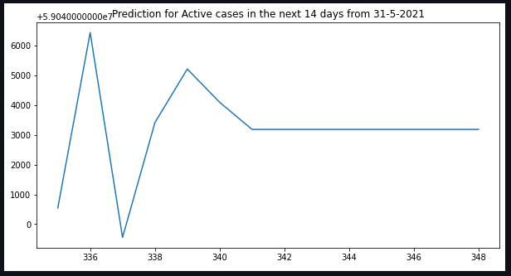
14-day forward prediction
(from May 31, 2021)
Global

Slide 69

14-day forward prediction
(from May 31, 2021) (cont.)
Brazil

Slide 70

14-day forward prediction
(from May 31, 2021) (cont.)
India

Slide 71

14-day forward prediction
(from May 31, 2021) (cont.)
Japan

Slide 72

14-day forward prediction
(from May 31, 2021) (cont.)
South Korea

Slide 73

14-day forward prediction
(from May 31, 2021) (cont.)
US

Slide 74

14-day forward prediction
(from May 31, 2021) (cont.)
Vietnam

Slide 75
Observations from RFR
The model shows negative results. In training progress of all datasets, the predicted value is far from the expected value. In the evaluation, forecast values ​​all seem to run in the opposite direction to the expected value.
In the prediction for the next 14 days after 31-5-2021, the value fluctuates around 3000 more cases then becomes stable. The prediction graphs are very minuscule for a big pandemic like Covid-19.
Random Forest can be good for classification but not as for regression problem as it does not give precise continuous nature prediction. In case of regression, it doesn’t predict beyond the range in the training data, and that they may over fir datasets that are particularly noisy.

Slide 76
ARIMA model
ARIMA, short for‘Auto Regressive Integrated Moving Average is actually a class of models that ‘explains’a given time series based on its own past values, that is, its own lags and the lagged forecast errors, so that equation can be used to forecast future values.
In ARIMA functions:
‘p’is the order of the‘Auto Regressive (AR) term. It refers to the number of lags of Y to be used as predictors
The value of d, therefore, is the minimum number of differencing needed to make the series stationary.
‘q’is the order of the‘Moving Average’(MA) term. It refers to the number of lagged forecast errors that should go into the ARIMA Model.

Slide 77
Pre-proposed method of ARIMA model
The evaluation criteria taking into account the Root Mean-Squared Error (RMSE).
The approximation technique considered for defining the three parameters (p, q, and d) of the ARIMA model was Grid Search CV, which tests a wide set of parameter matching implementations and selects the best fit.
The results were organized in the following sequence: Global, Brazil, United States, India, Japan, South Korea, Vietnam.

Slide 78

Prediction of ARIMA model
Prediction results of the ARIMA (p = 0, q = 1, d = 0) model for one sample of COVID-19 Infected cases time series globally. The blue line is the original data, while the red line is the prediction time series.
Brazil

Slide 79

Prediction of ARIMA model (cont.)
Prediction results of the ARIMA (p = 0, q = 1, d = 0) model for one sample of COVID-19 Infected cases time series from Brazil. The blue line is the original data, while the red line is the prediction time series.
Brazil

Slide 80

Prediction of ARIMA model (cont.)
Prediction results of the ARIMA (p = 0, q = 1, d = 0) model for one sample of COVID-19 Infected cases time series from the United States. The blue line is the original data, while the red line is the prediction time series.
US

Slide 81

Prediction of ARIMA model (cont.)
Prediction results of the ARIMA (p = 1, q = 2, d = 0) model for one sample of COVID-19 Infected cases time series from India. The blue line is the original data, while the red line is the prediction time series.
India

Slide 82

Prediction of ARIMA model (cont.)
Prediction results of the ARIMA (p = 0, q = 2, d = 1) model for one sample of COVID-19 Infected cases time series from Japan. The blue line is the original data, while the red line is the prediction time series.
Japan

Slide 83

Prediction of ARIMA model (cont.)
Prediction results of the ARIMA (p = 1, q = 1, d = 1) model for one sample of COVID-19 Infected cases time series from South Korea. The blue line is the original data, while the red line is the prediction time series.
South Korea

Slide 84

Prediction of ARIMA model (cont.)
Prediction results of the ARIMA (p = 3, q = 2, d = 0) model for one sample of COVID-19 Infected cases time series from Vietnam. The blue line is the original data, while the red line is the prediction time series.
Vietnam

Slide 85

Observations of ARIMA model
Table shows RMSE score of each country and the range of data for reference:
Examining the figures resulted from model processing reveals that the predicted data is somehow too similar to the actual data. All of the figures show a strange opposite trend in the predicted values ​​at the very beginning of each graph line. This may be an “overfitting” issue.
RMSE scores appear a little too big and have no analysis value.

Slide 86
05
Conclusion

Slide 87
Conclusion
The objective of this study is to provide some insights about the COVID-19 pandemic from data analytics perspective in a didactical and simple way. Predicted results should not be considered in any way an affirmation of what will happen in the future. Observations obtained from data exploration are personal opinions.

Slide 88
Thank you!

